Slide 1
Clinical Evaluation of a Novel 4D-CBCT Reconstruction Scheme Based on Simultaneous Motion Estimation and Image Reconstruction
J. Dang¹, X. Gu¹, T. Pan² and J. Wang¹
1. Department of Radiation Oncology, The University of Texas Southwestern Medical Center Dallas, Texas
2. Department of Imaging Physics, The University of Texas M.D. Anderson Cancer Center, Houston, Texas
Poster#: 57102
Session title: (DPD 09) Physics 2 - Emerging and Novel Physics Indications Session date: 2014-09-16 14:45 Location: Room D-1 Monitor number: 5

Slide 2
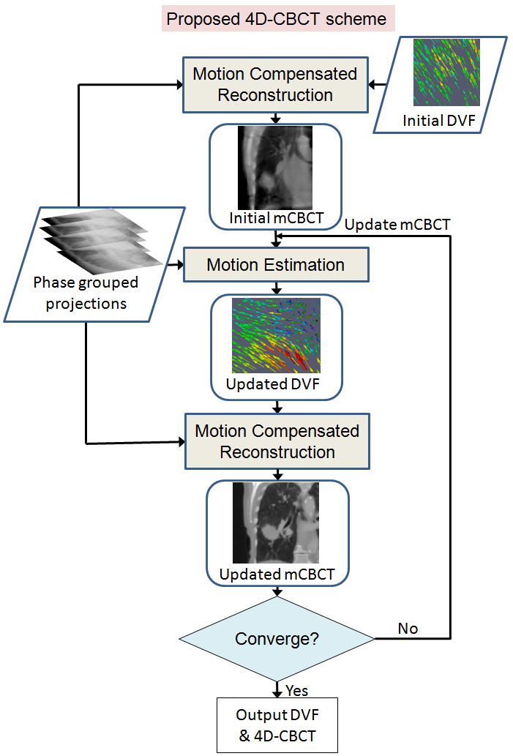
Current 4D-CBCT
Image reconstruction and motion estimation are handled in two sequential steps:
4D images individually reconstructed
Accuracy of motion estimation is limited by reconstructed image quality.
Our method: Simultaneous Motion Estimation and Image Reconstruction (SMEIR)
Two alternating steps
Motion compensated image reconstruction using projections from all phases
Update motion model from projections directly
Flowchart
of SMEIR
2/11

Slide 3
Patient study
4 patient datasets
All patients underwent long scanning time (4~6 min) to obtain good reconstructed image as patient reference
Total projection # : ~2000
Projections sorted into 10 phases, with average projection # ~200
Down-sample projection # per phase with factor of 5,8,10 to compare FDK / TV / SMEIR results with patient reference

Slide 4
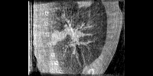
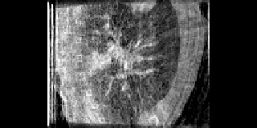
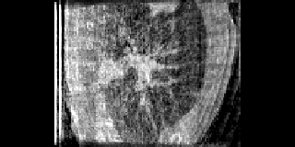
Image results
FDK
TV
SMEIR
Reference
Avg. Proj.
# 38
Avg. Proj.
# 24
Avg. Proj.
# 19

Slide 5
Tumor position RMSE & MaxE
Patient # | Average projection # per phase | FDK |  | TV |  | SMEIR
 |  | RMSE (mm) | MaxE (mm) | RMSE (mm) | MaxE (mm) | RMSE (mm) | MaxE (mm)
1 | 38 | 1.16 | 1.90 | 0.50 | 1.20 | 0.18 | 0.40
2 | 33 | 1.38 | 2.54 | 0.51 | 1.03 | 0.15 | 0.26
3 | 39 | 0.96 | 2.25 | 0.50 | 1.05 | 0.31 | 0.71
4 | 33 | 1.58 | 3.01 | 0.98 | 1.42 | 0.39 | 0.43
Conclusion
All <1 mm
SMEIR algorithm achieves sub-mm tumor tracking accuracy when the average projection number per phase is 30~40.
The SMEIR algorithm enables the use of the conventional 1-minute CBCT for accurate motion modeling and 4D-CBCT reconstruction.

