Slide 1
Hybrid Dual Energy (HDE) Fluoroscopy for Real-Time Tracking of Lung Tumors
JC Roeske PhD, R Patel PhD, M Campana BS,
J Panfil BS, M Surucu PhD, AM Block MD,
M Harkenrider MD
Loyola University Medical Center,
Maywood, IL 60153

Slide 2
Background
Dual energy (DE) imaging uses high and low kVp images to perform a weighted subtraction and produce soft tissue images
Elimination of bone results in improved visualization of lung tumors
Combining DE with fluoroscopy may provide ability to perform markerless-motion tracking
This would require hardware upgrades to most on-board imaging systems
A hybrid approach is described that uses DE images from single frame, and applies this to subsequent fluoroscopy images

Slide 3
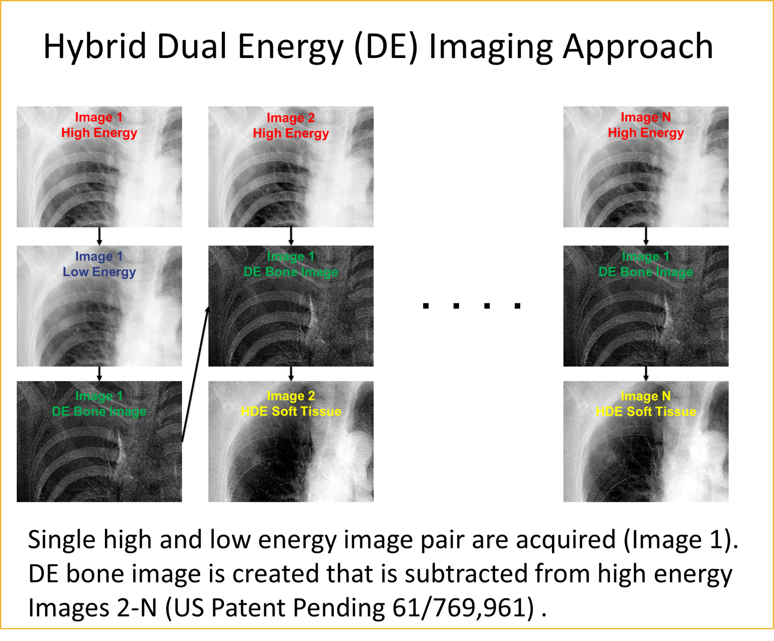

Slide 4
Results and Conclusions
Comparison of template-based motion tracking between HDE and frame-by-frame DE subtraction showed no statistical difference in tracking coordinates or tumor detectability
This approach may allow for markerless tracking of lung tumors using existing on-board imaging systems with only minor software enhancements

